Slide 1
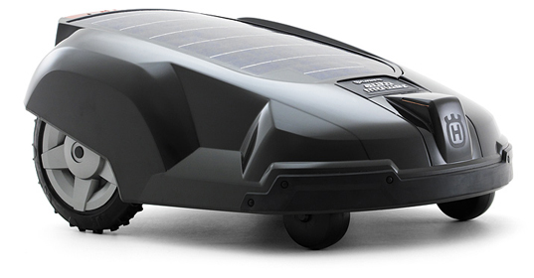
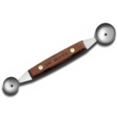
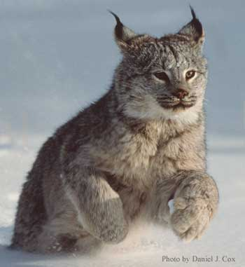
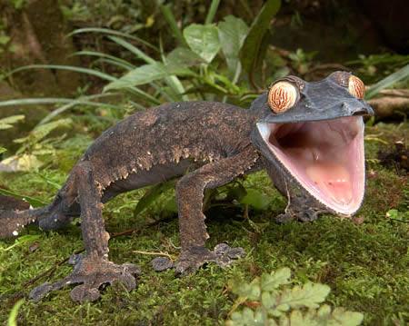
What to do about
The Object That Cannot Be Named?
Derek Hoiem
Computer Science Department
University of Illinois at Urbana- Champaign
Notes:
Shared representations
Strong supervision
Localize without identifying.

Slide 2
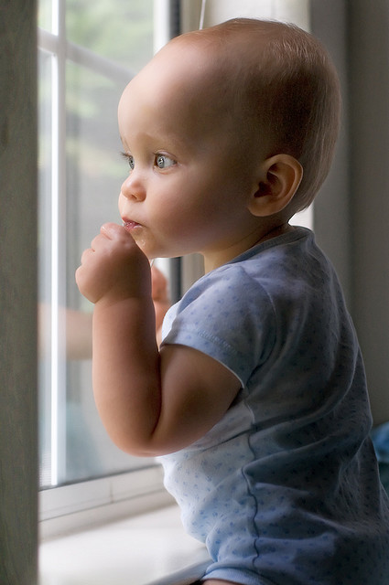
A failure/success story
Photo by Ivan Makarov
Notes:
I’ll start with a little story about my nephew Max. When Max was two, we visited my sister-in-law for Thanksgiving. Just as we were all sitting down, suddenly, Max toddled off toward the window and pointed – doog doog. That’s how he says “dog”. So we all went over to see what he was looking at, and guess what? It was not a dog. It was a deer. This story is mundane and could apply to any infant, but what’s interesting is that it is a failure story according to today’s recognition algorithms, but really a success story in terms of recognition ability….

Slide 3
Dealing with inevitable failure
Failure in categorization should not mean failure in recognition
Notes:
We need recognition algorithms like Max’s. Not necessarily that have the same architecture or mechanisms. But recognition algorithms that are functional despite frequent failure. I could probably train an object detector that would beat Max in AP, yet Max is able to move around, interact with things, make predictions, and communicate, while a robot with my vision algorithm wouldn’t survive for five minutes. We need vision systems that start with a basic assumption that they will often be wrong – that they will often not be familiar with an object or may mistake its identity. When these systems do encounter something new, they should be able to accommodate it into existing concepts, refining them, not redefining them.

Slide 4
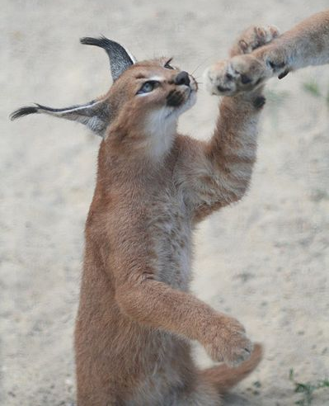
Key question
What to do about the
Object That Cannot Be Named?
Notes:
In this talk, I’ll focus on this one question: “What to do about the object that cannot be named.” If we can answer this question, we can have systems that are increasingly useful as they improve in visual ability. If not, anything short of perfection will yield a failed system. Let me give you a couple examples.

Slide 5
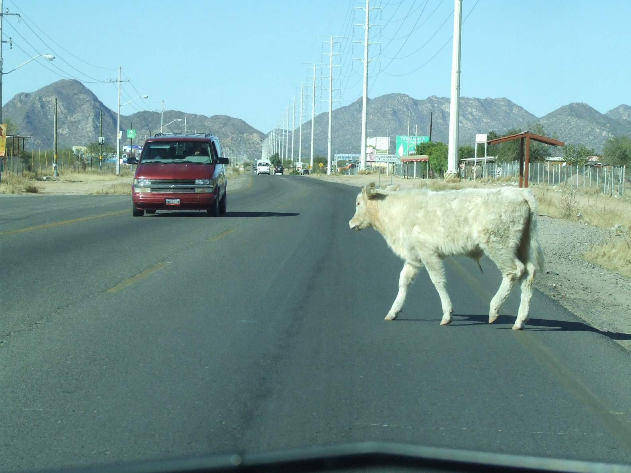
Example
Assisted Driving
Notes:
This problem really matters. We encounter new types of objects all the time, and we need to deal with them. Consider the problem of assisted driving…

Slide 6

Example
Security
Notes:
Likewise, security, household robots, etc.

Slide 7
Key steps
We need richer, more interconnected object representations

Slide 8
What makes a good object representation?
Prediction
  Where will it go, what will it do, how could I use it?
Description
  What is it, what is it doing, what does it look like?
Generalization
  Applicable beyond the immediate task
Composition
  New, related objects and tasks are easier to learn

Slide 9
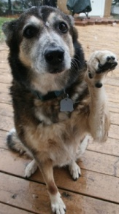
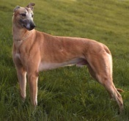
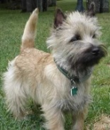
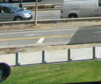

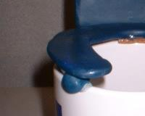
Current View of Recognition
Training
Examples
Appearance Representation
Appearance Model
Object Representation
LAB Histogram
x
x
x
x
x
Textons
o
Dog
Not Dog
x
o
x
o
o
HOG
o
x
Bag of SIFT
x

Slide 10
Current View of Recognition
Training
Examples
Appearance Representation
Appearance Model
Object Representation
LAB Histogram
x
x
x
x
x
Textons
o
Dog
Not Dog
x
o
x
o
o
HOG
o
x
Bag of SIFT
x
Lots of effort – fancy stuff

Slide 11
Current View of Recognition
Training
Examples
Appearance Representation
Appearance Model
Object Representation
LAB Histogram
x
x
x
x
x
Textons
o
Dog
Not Dog
x
o
x
o
o
HOG
o
x
Bag of SIFT
x
Not much changed

Slide 12
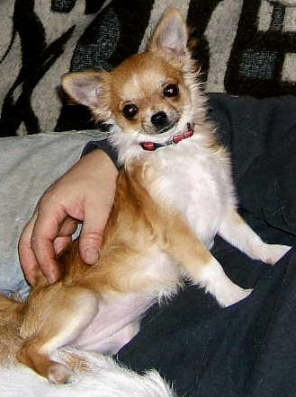
Value of basic categories
Has head
Is animal
Is furry
Is small
Can be pet
Eats meat
DOG

Slide 13
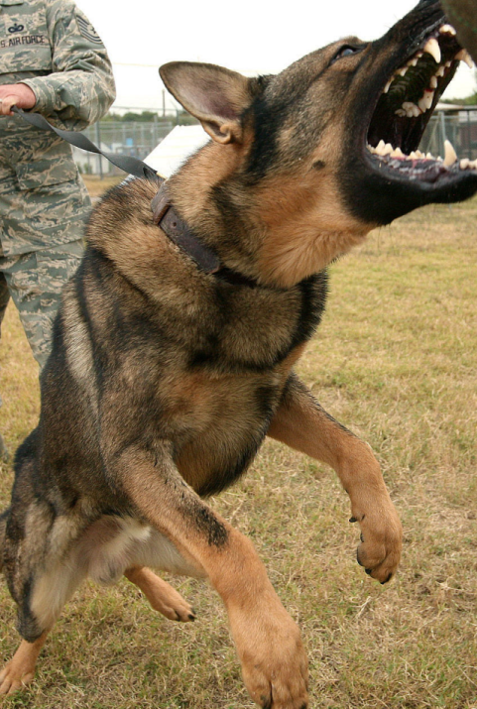
Limitations of basic categories
They provide limited prediction and description
DOG
DOG
?

Slide 14
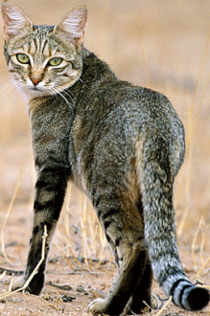
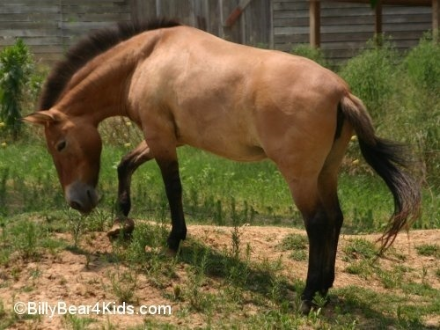

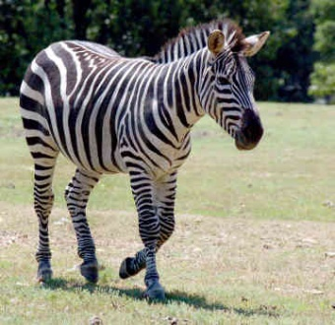
Limitations of basic categories
They do not apply to objects from novel categories
Familiar Objects
New Object
Cat
Horse
Dog
???

Slide 15
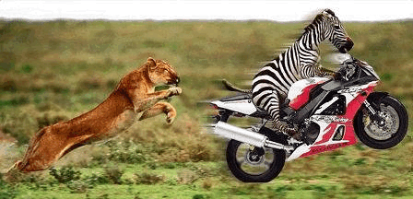
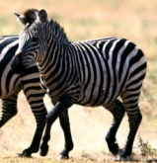
Limitations of basic categories
They do not make it easier to learn new categories
Appearance Features
Dog
Classifier
Dog
Not Dog
Appearance Features
Zebra
Classifier
zebra
Not zebra

Slide 16
Category-based representation
Limited description and prediction
No generalization to objects outside of learned categories
Provides little guidance for learning
So what would make a better representation?

Slide 17
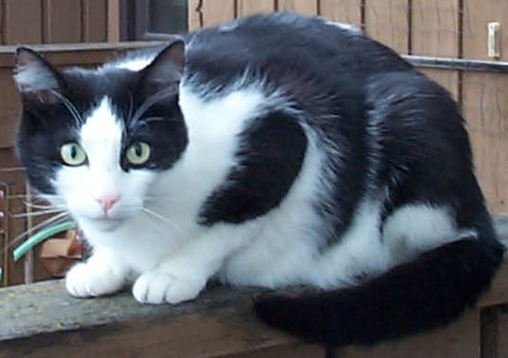
Attribute-based Representation
Learn intermediate structure with object categories
ears
fur
Multiple Categories
animal, land animal, …, cat
Viewpoint/pose
lying down, left side, facing camera
Function
fast runner, climb trees, eat small animals, jump high, household pet, scratch
eyes
mouth
tail
feet

Slide 18
What I mean by attributes
Properties that we want to describe or predict
Shared across basic categories
Made explicit through supervision
ears
fur
Multiple Categories
animal, land animal, …, cat
Viewpoint/pose
lying down, left side, facing camera
Function
fast runner, climb trees, eat small animals, jump high, household pet, scratch
eyes
mouth
tail
feet

Slide 19
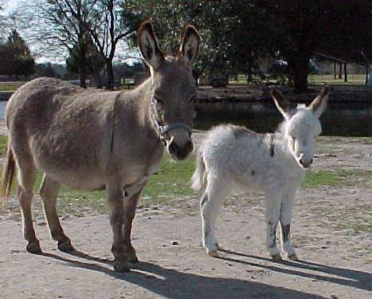
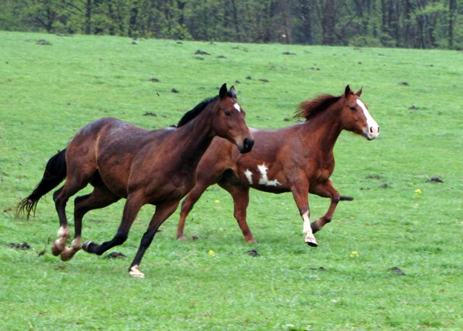
What do these attributes get us? (besides carpal tunnel syndrome)
Image Level
Contains donkey
Detailed Attributes Level
Categories
Animal
Land animal
Mammal
Four legged animal
Elk
Pose
Lying down = 1
Back = 1
…
Functional
Can see
Can walk
Herbivorous
…
Material
Pixel segmentations
Object Level
Horse
Horse

Slide 20
Advantages of supervised attributes
Enables verbal description of objects and images
Large angry dog with pointy teeth

Slide 21


Advantages of supervised attributes
Provides correspondence for objects from different categories
HEAD
STANDING
HEAD
SITTING
LEG
LEG
HEAD
STANDING
LEG
Notes:
Add two figures for correspondence

Slide 22
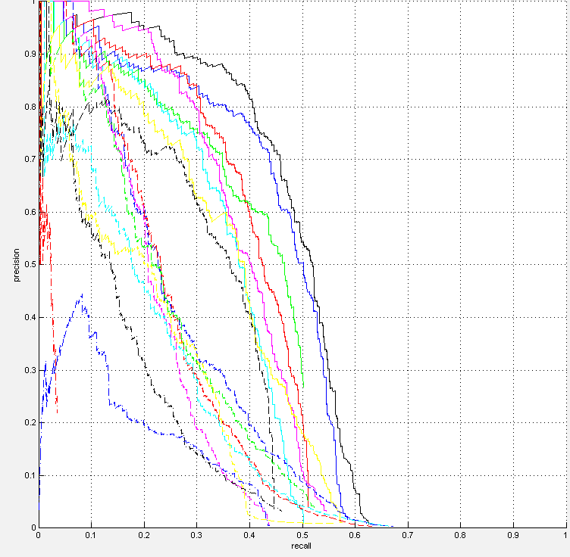
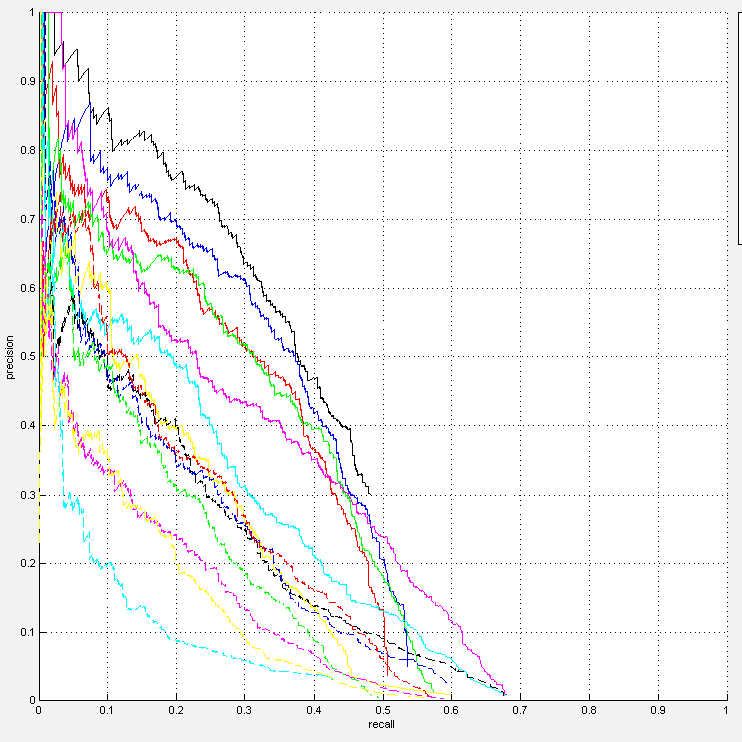
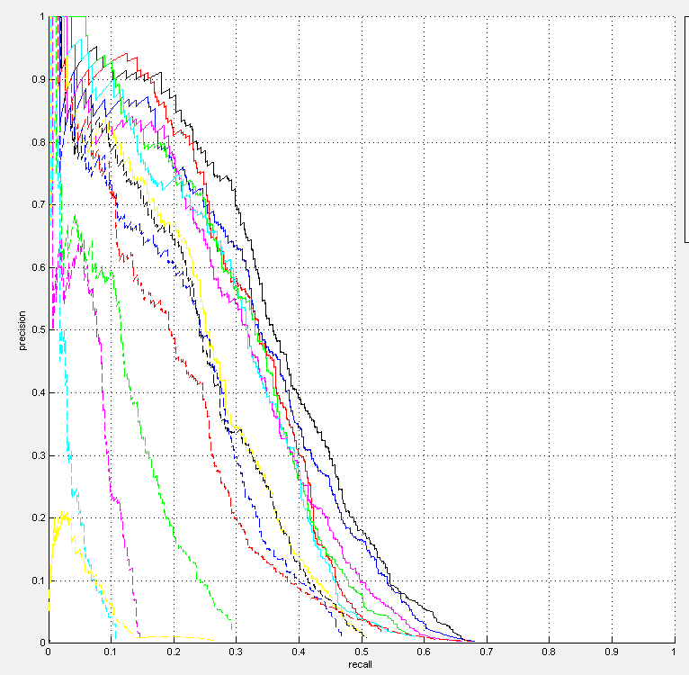
Advantages of supervised attributes
Provides correspondence for objects from the same category
  The mystery of the missing 40%
cat
tvmontior
60%
aeroplane
60%
60%
Notes:
One sign of the need for this is what I call the mystery of the missing 40%...

Slide 23
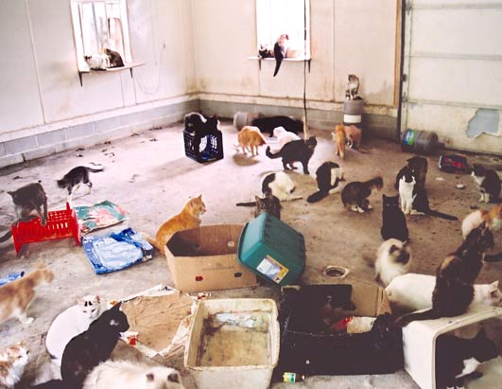
Advantages of supervised attributes
Provides correspondence for objects from the same category
  The mystery of the missing 40%
Notes:
One sign of the need for this is what I call the mystery of the missing 40%...

Slide 24
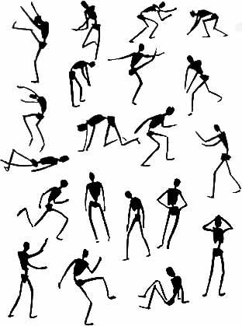
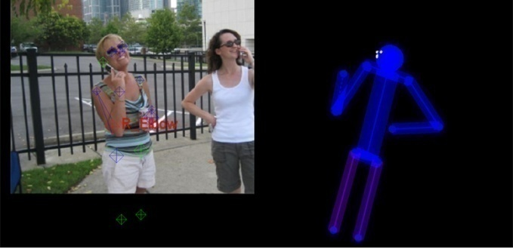
Advantages of supervised attributes
Provides correspondence for objects from the same category
Poselets: Bourdev and Malik 2009
Notes:
Add two figures for correspondence

Slide 25
Strong vs. weak supervision?
Image Level
Contains donkey
Detailed Attributes Level
Categories
Animal
Land animal
Mammal
Four legged animal
Elk
Pose
Lying down = 1
Back = 1
…
Functional
Can see
Can walk
Herbivorous
…
Material
Pixel segmentations
Object Level
Horse
Horse

Slide 26
Strong vs. weak supervision?
What supervision do we need to learn predictive and descriptive object models?
How do we maximize learning from available annotation?

Slide 27
Bottom Line
We must not sacrifice representation to avoid annotation.
Notes:
The bottom line is that, as a practical matter, we’d like to get away with little supervision, but lack of annotation is never an excuse for poor representation.

Slide 28
Our recent efforts
with Ali Farhadi and Ian Endres (CVPR 2010)
Also see (among other recent works + many older works)
Lampert Nickisch Harmeling (CVPR 2009)
Farhadi Endres Hoiem Forsyth (CVPR 2009)
Kumar Berg Belhumeur Nayar (ICCV 2009)
Stark Goesele Schiele (ICCV 2009)
Bourdev Malik (ICCV 2009)
Palatucci Pomerleau Hinton Mitchell (NIPS 2009)
Tang Tappen Sukthankar Lampert (CVPR 2010)
Rohrbach Stark Szarvas Schiele (ECCV 2010)
Notes:
We have collected a dataset, with detailed annotation and newly proposed challenges
We have shown that part and broad category detectors can generalize across categories
We have shown that, even with simple methods to integrate them, the parts and broad category detectors make a big difference in object localization and description
We have demonstrated the ability to describe new objects

Slide 29



Domain-based Recognition
Basic-Level Categories
Superordinate Categories
Parts
…
Cat
Detector
Dog
Detector
Head Detector
4-Legged Animal Detector

Slide 30
Domain-based Recognition
Cat
Detector
Dog
Detector
4-Legged Animal
4-Legged Animal Detector
Head
Head Detector
Walking Left

Slide 31
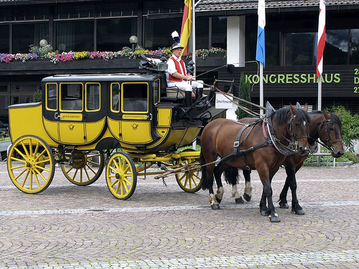
Domain-based recognition: overview
Voting using Shared Spatial Models
Trained Detectors
Basic Level Categories
Elephant, Dog, Eagle, Camel, Lizard, Bat,
Dog, Penguin, Monkey, …
Vehicle
Animal
Object Localization
Broad Categories
Four-legged Animal, Mammal, Water Animal, Animal
Attribute Predictors
Animal
Four-legged
Mammal
Head
Object Description
Can run
Can Jump
Is Herbivorous
Facing right
Parts
Leg, Horn, Wing, Head, Eye, Ear, Foot, Mouth, Nose, Tail
Leg

Slide 32
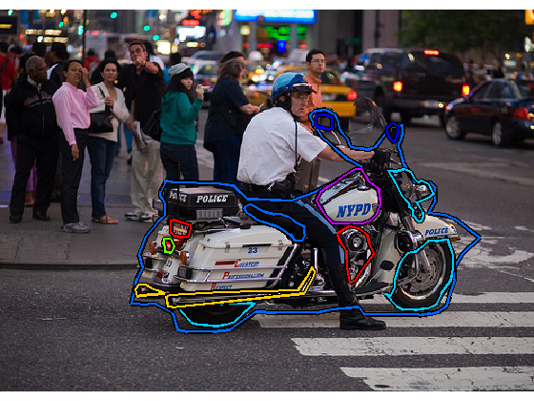
CORE Dataset
Annotation Example
Mirrors
Vehicle
Two-wheeled
Motorcycle
Gas tank
Seat
Headlight
Lic. Plate
Facing right
On the street
Has a rider
Motorcycle
Tail light
Metal
Exhaust
Rubber
Engine
Wheel
Wheel

Slide 33
CORE dataset
Cross-category Object REcognition
2780 Images – from ImageNet
3192 Objects – 28 Categories
26695 Parts – 71 types
30046 Attributes – 34 types
1052 Material Images – 10 types
Download or browse online:
http://vision.cs.uiuc.edu/CORE

Slide 34
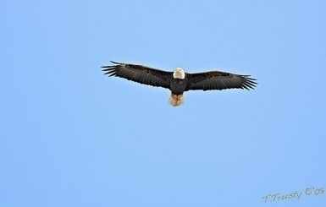
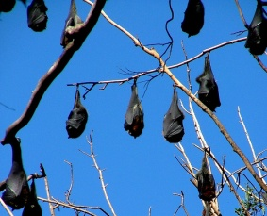
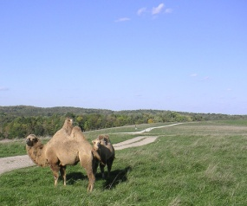
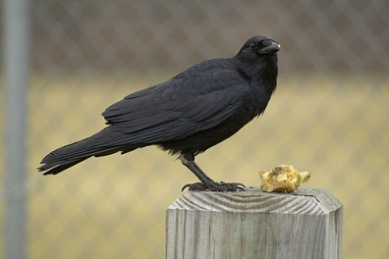
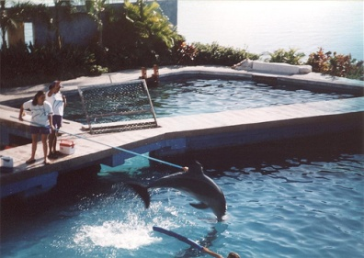
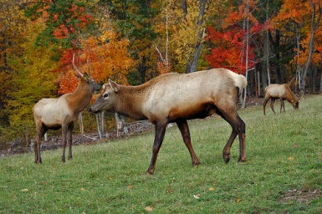
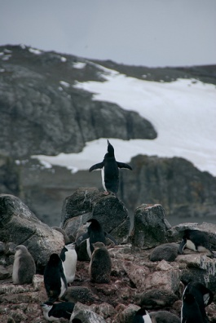
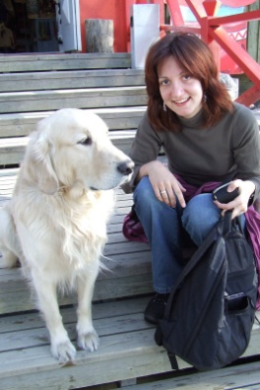
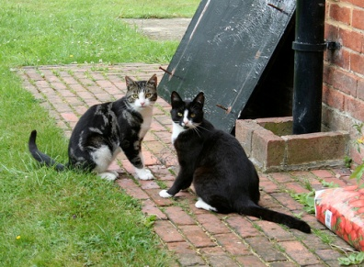
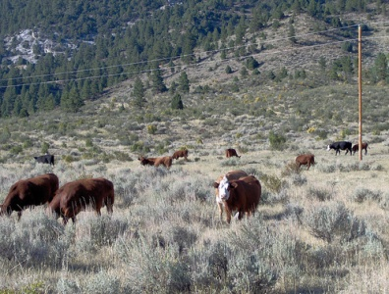
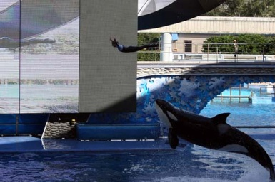
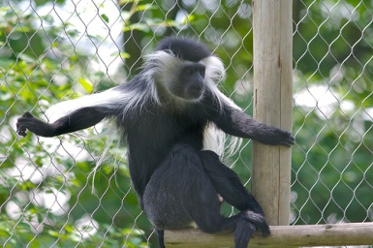
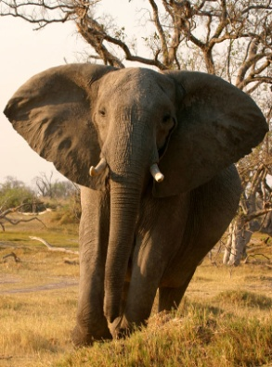
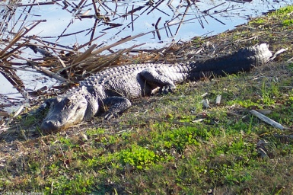
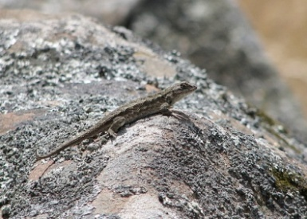
Dataset examples: animals
Categories Seen During Training and Testing
Categories Seen Only During Testing

Slide 35
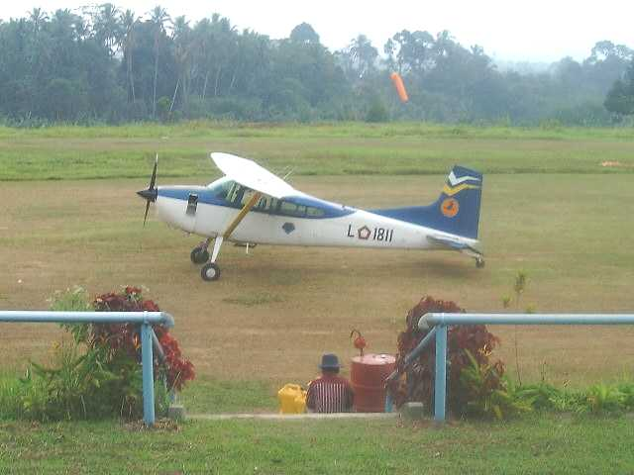
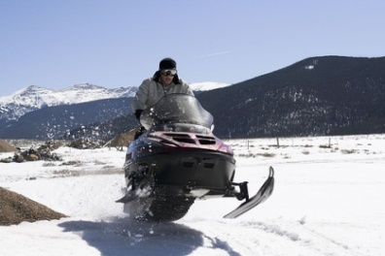
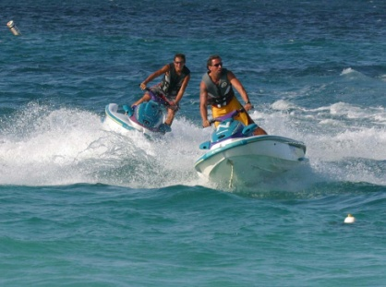
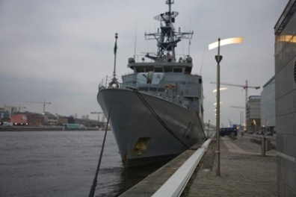
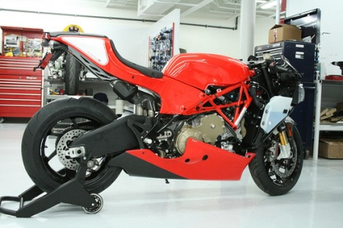








Dataset examples: vehicles
Categories Seen Only During Testing
Categories Seen During Training and Testing

Slide 36

Result: Part detectors can generalize across categories
Part Detections for Novel Object
Hump
Head
Leg
Detectors trained using (Felzenszwalb Girshik McAllester Ramanan 2009) method

Slide 37
Result: Broad category detectors can generalize across basic categories
Category Detections for Novel Object
Four-legged Animal
Mammal
Animal
Mammal
Detectors trained using (Felzenszwalb Girshik McAllester Ramanan 2009) method

Slide 38
Result: We can better find and describe objects from familiar categories
Trunk
Trunk
Leg
Leg
Foot
Foot
Foot

Slide 39
Result: We can better find and describe objects from familiar categories
ROC for Localization of Familiar Objects

Slide 40
Result: We can better find and describe objects from familiar categories
AUC for Attribute Prediction for Familiar Objects
Baseline: Infer from Basic Categories
Our Method: Infer from All
Animals
Vehicles

Slide 41
Result 3: We can find and describe objects from novel categories
Four-legged
Mammal
Animal
Vehicle
Head
Wheel
Leg
Can run
Can Jump
Is Herbivorous
Facing right
Moves on road
Facing right

Slide 42
Result using only basic categories
Elk
Semi Truck
Eagle
Snowmobile
Camel
Dog

Slide 43
Result 3: We can find and describe objects from novel categories
ROC for Localization of Unfamiliar Objects

Slide 44
Result 3: We can find and describe objects from novel categories
AUC for Attribute Prediction for Unfamiliar Objects
Baseline: Infer from Basic Categories
Our Method: Infer from All
Animals
Vehicles

Slide 45
Summary of Findings
Current detectors are good enough to recognize general parts and broad categories
Learning to recognize parts and broad categories improves both detection and description
By going beyond categories, we can partially recognize novel objects

Slide 46
Key steps
1. We need richer, more interconnected object representations.
2. We need mechanisms to localize objects that we cannot name.

Slide 47

Current approach to localization: per-category sliding window
Dog
Cat
Car
Train
…

Slide 48


Localization without Identification
Find objects without searching for each category individually
Be able to say “What is that?”
Endres Hoiem ECCV 2010
See also:
Alexe Deselaers Ferrari CVPR 2010
Carreira Sminchisescu CVPR 2010
More at ECCV

Slide 49







Our Approach
Generate Proposals:
Maximize recall
Rank Proposals:
Small diverse set of object regions
1 2 3 4 ...

Slide 50



Generating Regions
1. Select Seed
2. Compute affinities for seed
Repeat
4. Generate Regions
3. Construct binary CRF
+
Pairwise term:
Occlusion Boundaries
Unary term: Affinities

Slide 51
Ranking Regions
Learn weights to rank region based on appearance and diversity

Slide 52












Experimental Setup
Train on 200 BSDS images
Test 1: 100 BSDS images
Test 2: 512 Images from Pascal 2008 Seg. Val.

Slide 53


Results
Pascal

Slide 54


Results
BSDS
(Rank, % overlap)

Slide 55

Results on PASCAL
Recall (Region Measure) for PASCAL VOC 2008 Val

Slide 56
Very High Recall in PASCAL
Recall (Region Measure) for PASCAL VOC 2008 Val

Slide 57
Conclusions
In early recognition systems, most objects will not be precisely identifiable
Crucial question: What should a recognition system do
about these objects?
We need to adapt both representation and
mechanism
  Emphasize accurate prediction and description of many objects, rather than categorization of a few
  Learning and search should be easier as new categories are added
We have the tools to solve these problems – much to be
done.
Notes:
Improvements:
Speed up intro (maybe to 15 minutes). It drags on a bit.
Provide a little more detail about the CVPR 2010 and the ECCV 2010 work.
May need to practice this. It’s not quite working.

Slide 58


Thank you!
Animal
Vehicle
Four-legged
Mammal
Head
Wheel
Leg
Can run
Can Jump
Is Herbivorous
Facing right
Moves on road
Facing right
Funding:

